Slide 1
Video Gambling Presentation
By: John Leonard

Slide 2
Background
What is it?
At its core it’s a random number generator
They assign numbers based on the different valued symbols.
There are 50 symbols
The more valuable symbols to appear on the wheel as much as the common symbols
This puts the odds to 300 million to one that you win
They are luck based

Slide 3
Why I chose Video Gambling
Older Friends at Millikin would talk about using them alot
I see them everywhere in my personal life
There are businesses in decatur dedicated to video gambling
I never understood gambling

Slide 4
Problem
I wanted to see if there is a correlation between the amount being spent on video gambling and the unemployment rate.
Are they directly related?
If more is spent on video gambling does the unemployment rate go up?
If the is a direct relationship we need to regulate where the machines are placed and how many you can have in an establishments.

Slide 5
Research
I used RJ’s link to the Video gambling data
I decided to go with what i could of 2020
I used all of 2018-2019
Used what i couldn’t get out of 2020 from 2017
I struggled to find unemployment data
I search through all the major bureaus to find
Rj pointed me in the right direction to Illinois Department of Employment Security
I used 2017-2019 as my years

Slide 6
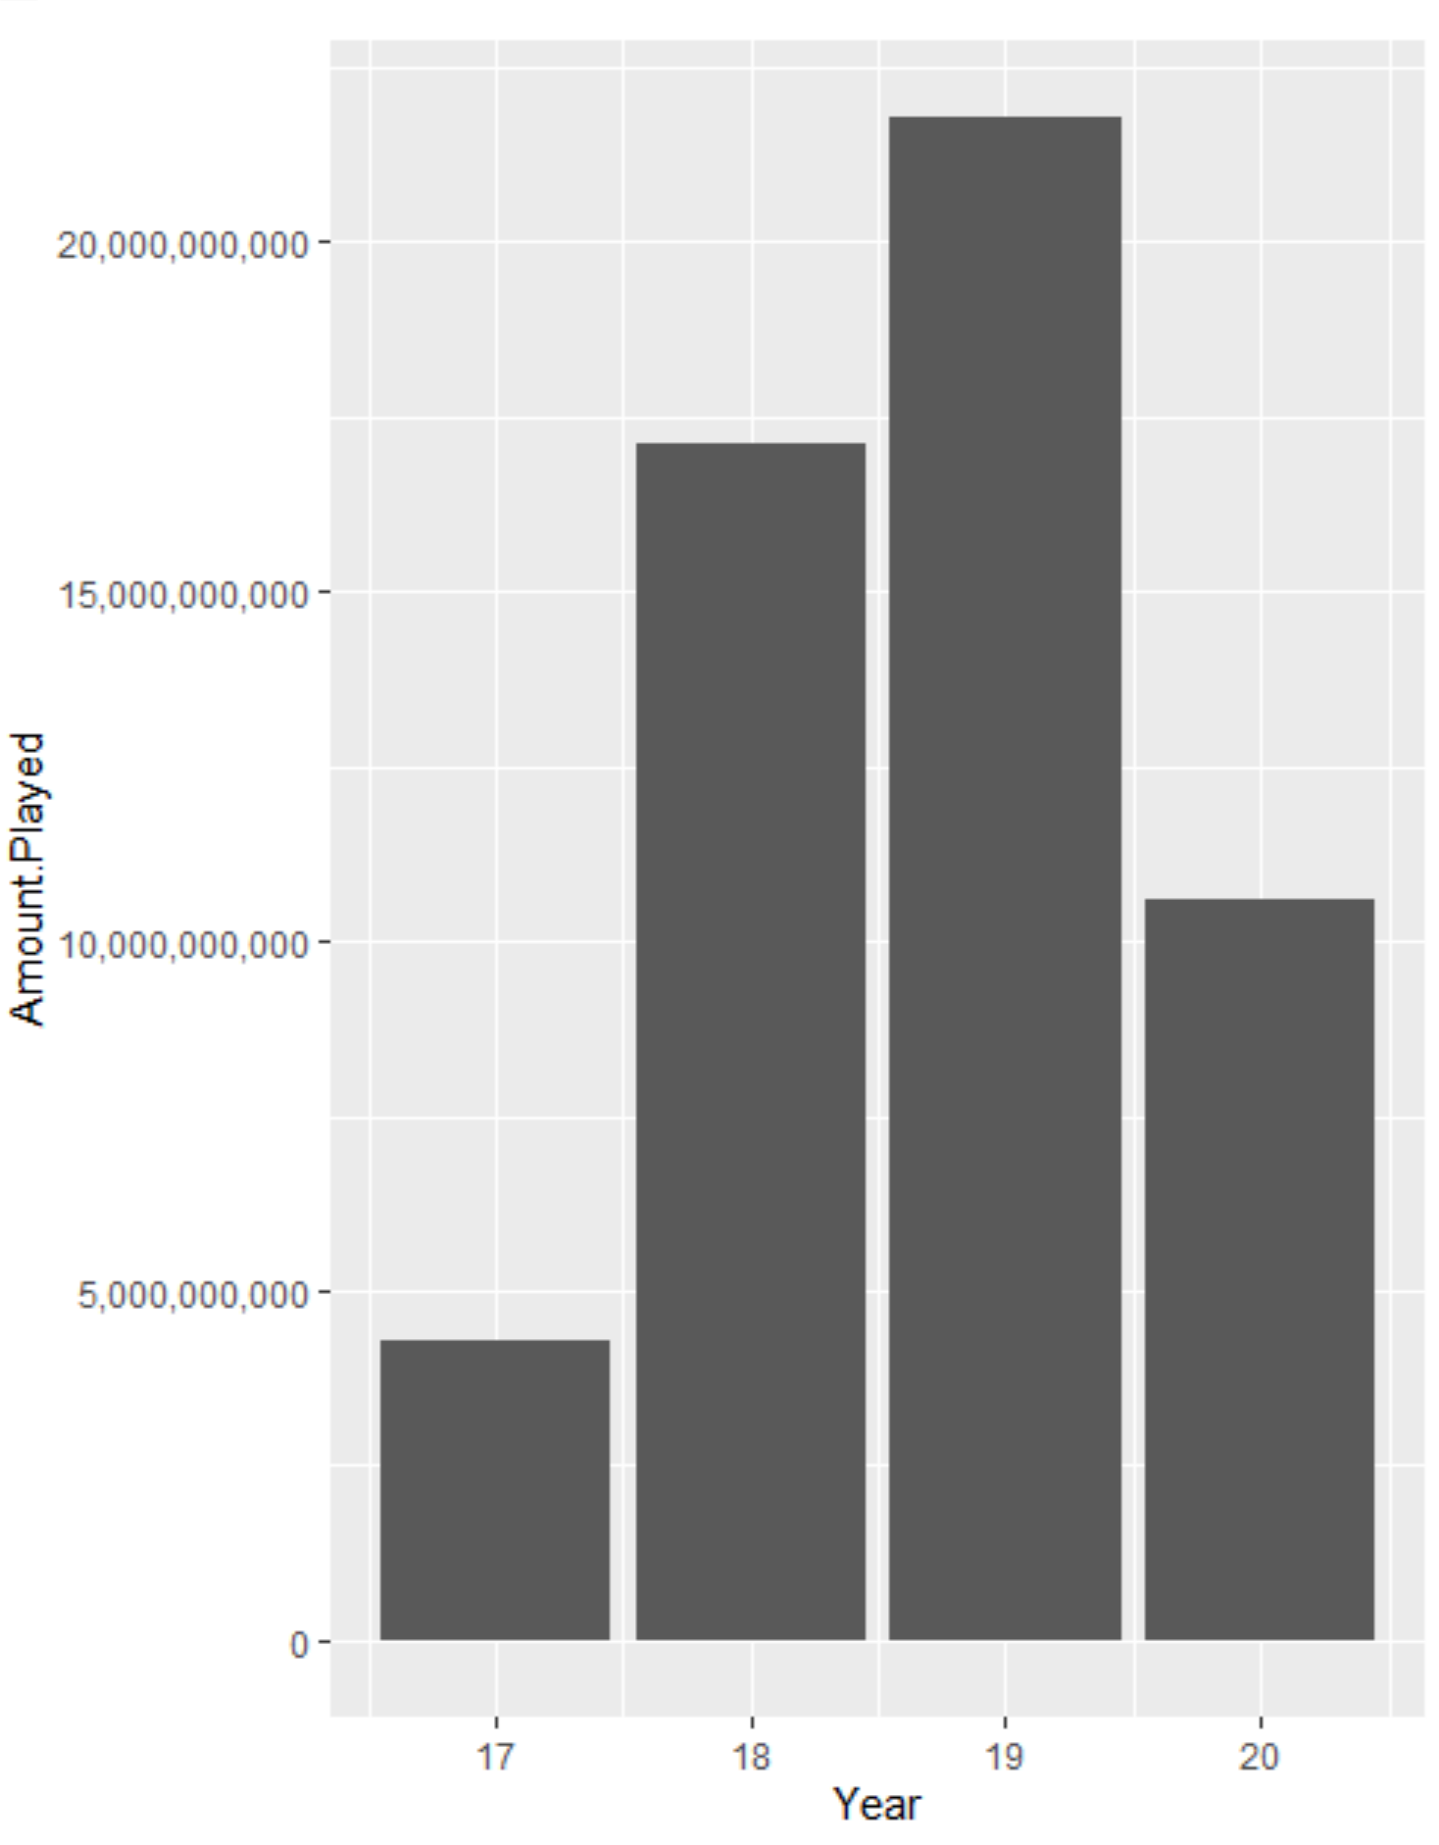

Slide 7
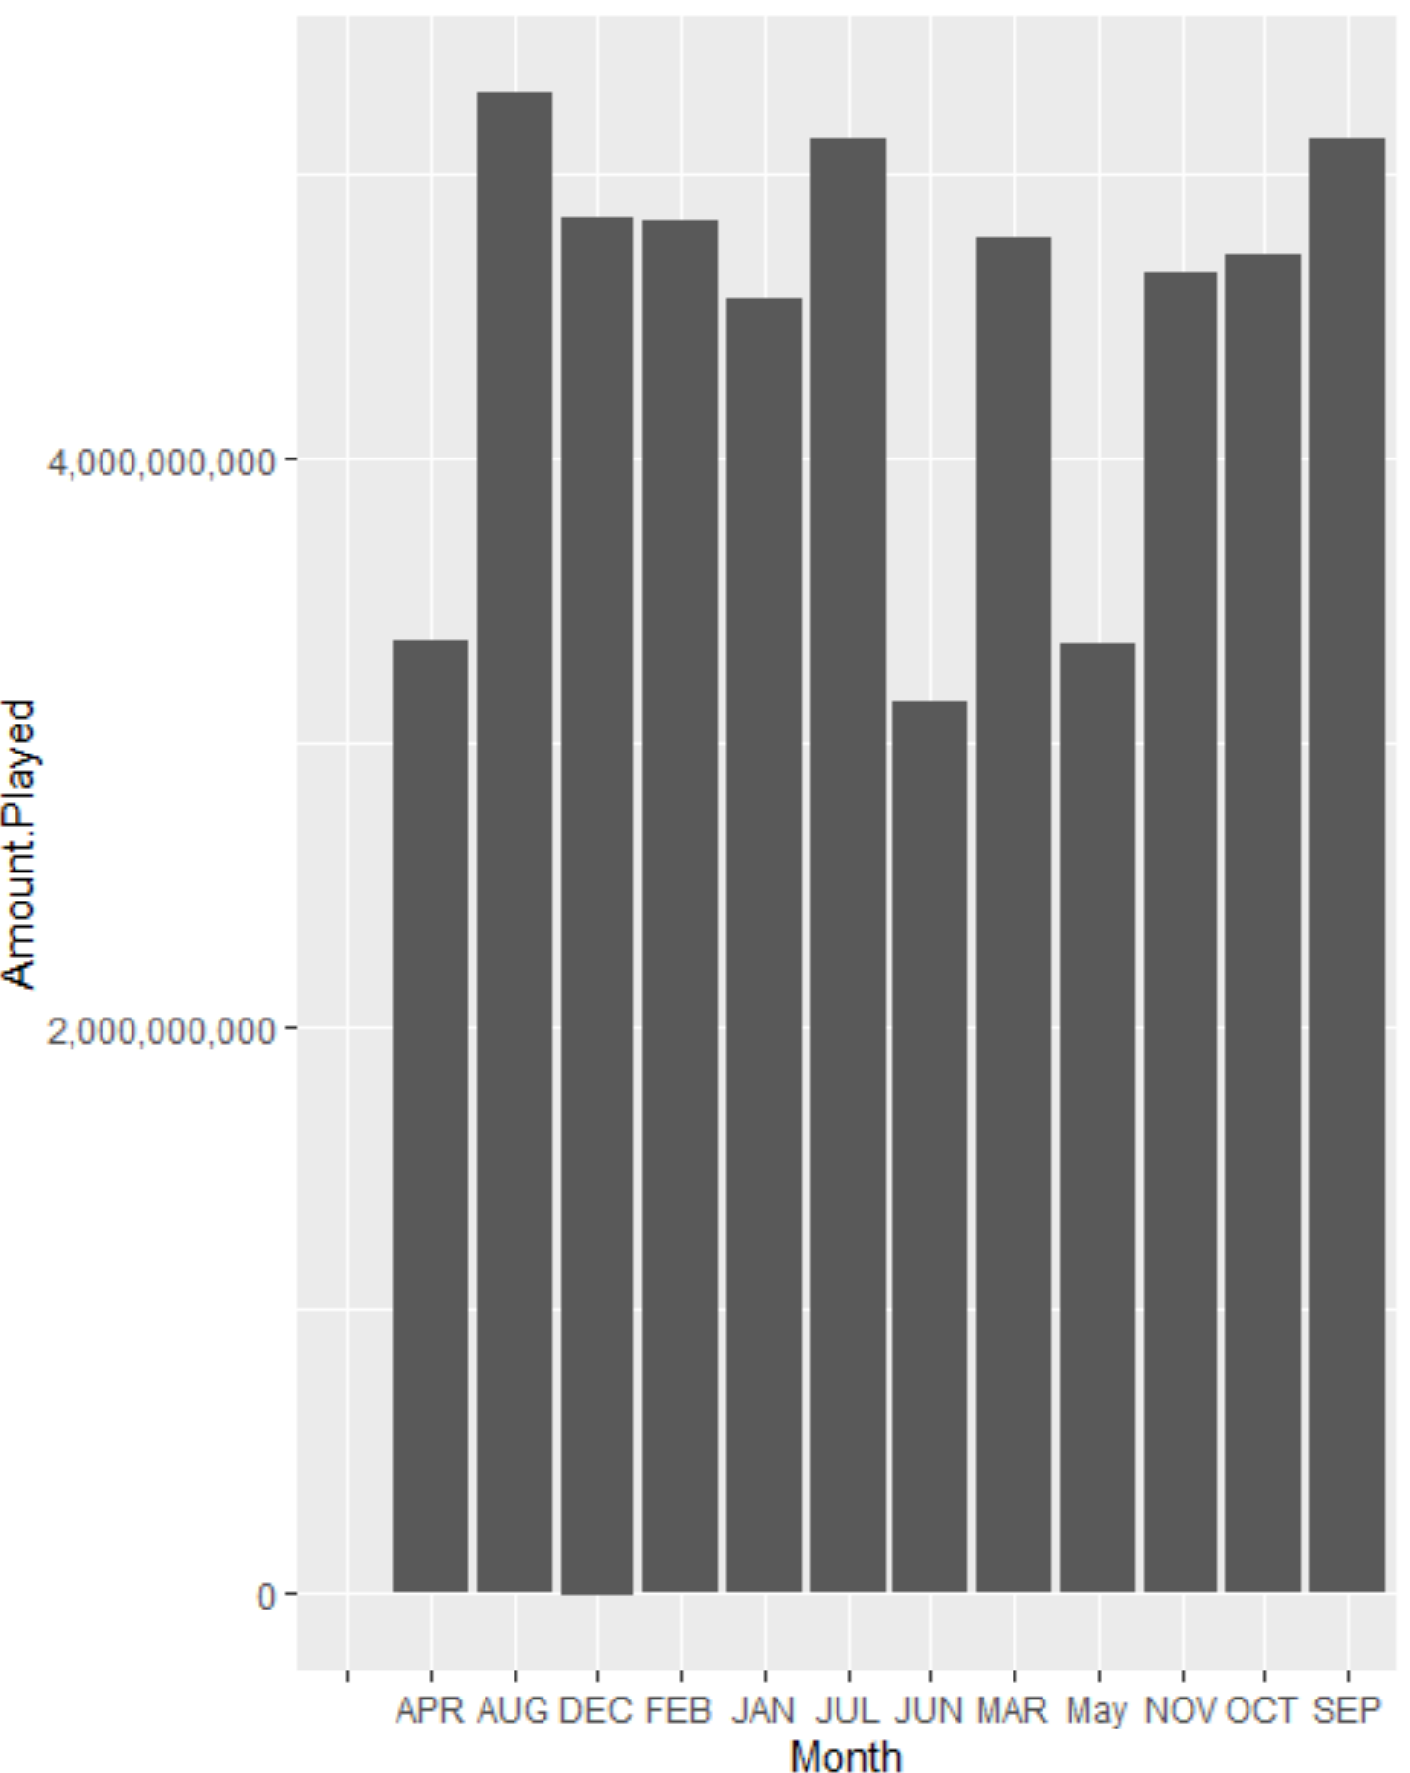

Slide 8
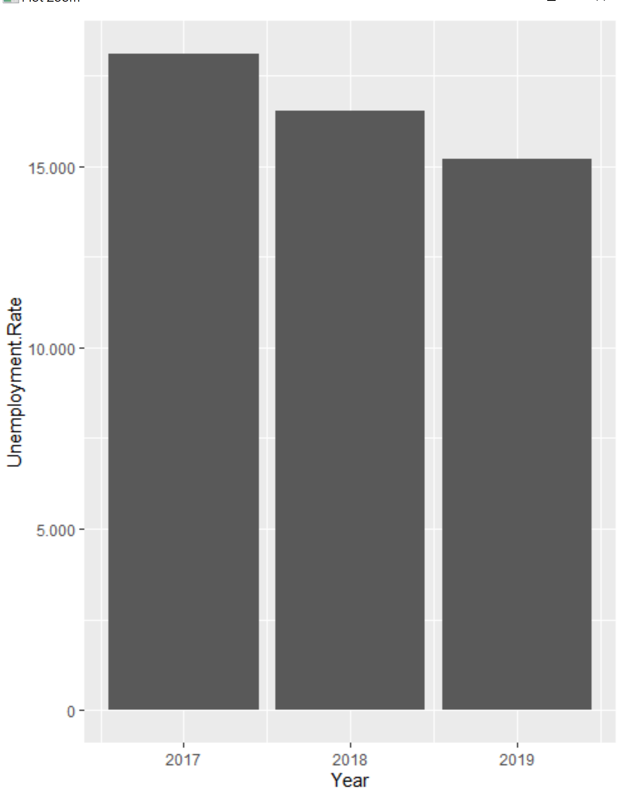

Slide 9
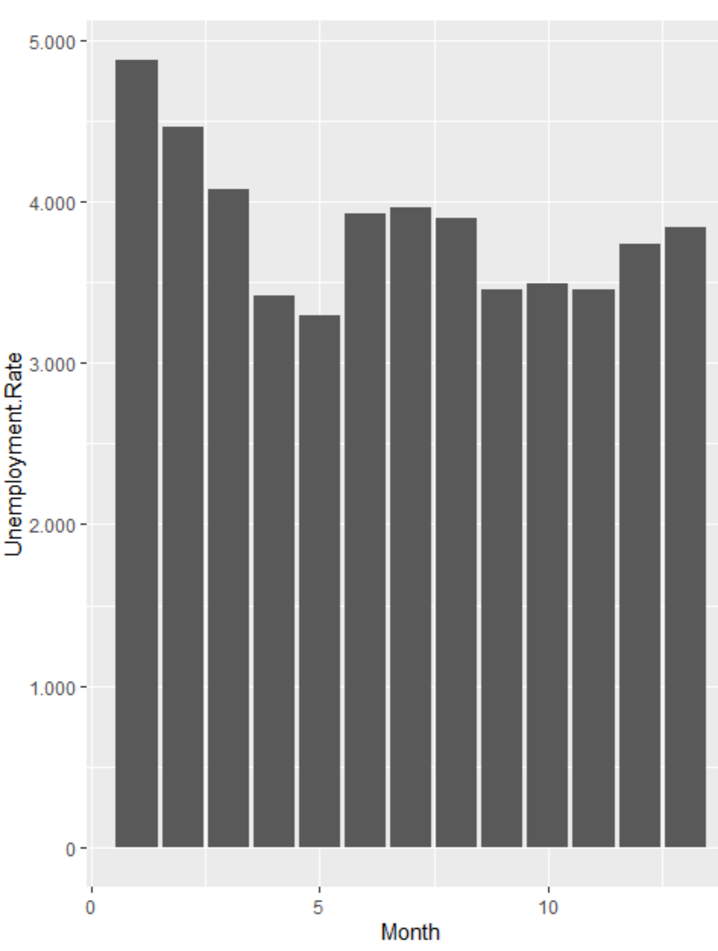

Slide 10
Recommendations
I have no recomendations

Slide 11
Things I have learned
Be careful when cleaning up your data
Make sure everything is labeled properly
People send a lot on video gambling
Every town has some sort of video gambling

